Slide 1
Gremlin, Table, Mongo and Casandra APIs for Azure Cosmos DB
Module 5

Slide 3
Learning Units covered in this Module
Lesson 1: Gremlin API for a Graph Data Model
Lesson 2: Table API for a Key-Value Data Model
Lesson 3: Mongo DB API
Lesson 4: Casandra API

Slide 4
Lesson 1: Gremlin API for a Graph Data Model

Slide 5

Objectives
After completing this learning, you will be able to:
Understand Graph Data Model
Understand Cosmos DB Graph Support
Understand Data Migration tools supported by Cosmos DB Graph API

Slide 6
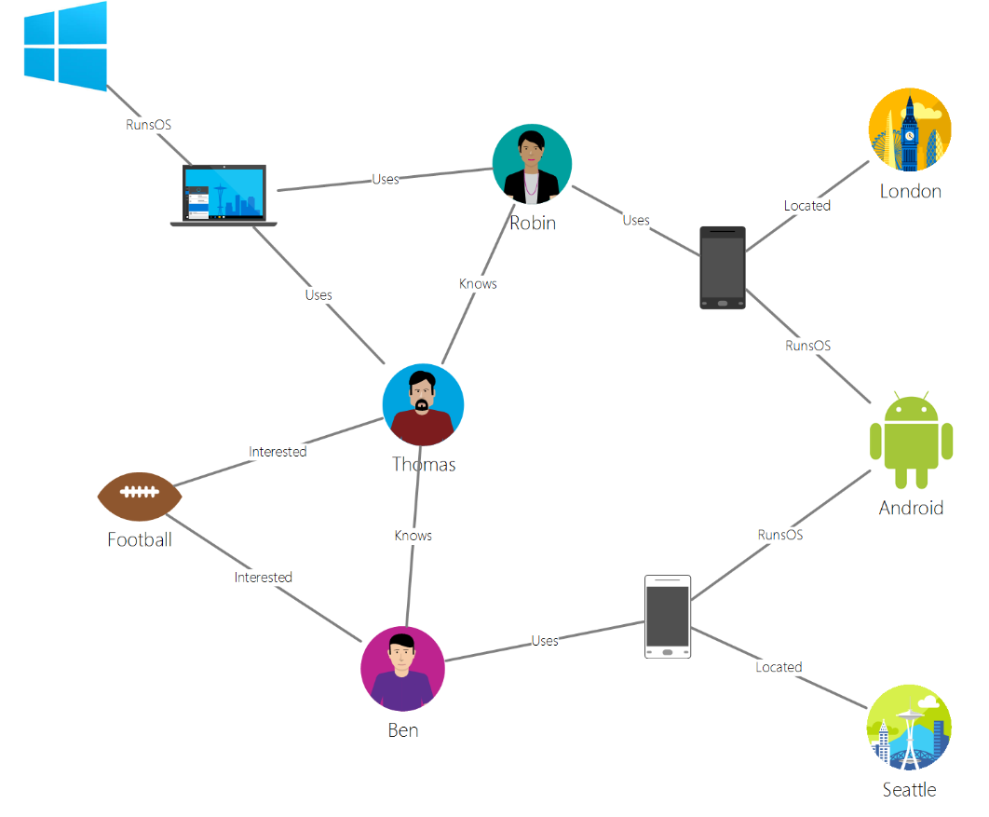
Graph Data Model
Entities store the relationship along with the data.
Data retrieval on relationships is very efficient.
Data consists of Vertices, Edges and Properties.
Notes:
In Graph data model the relationship between different entities are stored along with the data. An Entity can have any number of properties or relationships with any number of entities.
The data retrieval on condition of a relationship between the entities becomes very efficient.

Slide 8

Demonstration
Notes:
Consider demoing the following:
-
##########

Slide 9
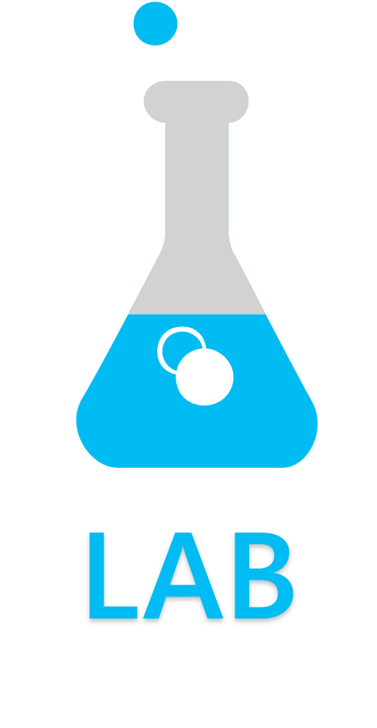
Notes:
Link to lab:
##########

Slide 10

Questions?

Slide 11
Knowledge Check
<Question 1>
<Question 2>
<Question 3>
<Question 4>
<Question 5>
<Question 6>

Slide 12
Lesson 2: Table API for a Key-Value Data Model

Slide 13
Objectives
After completing this learning, you will be able to:
Understand the migration tools

Slide 15
Demonstration
Notes:
Consider demoing the following:
-
##########

Slide 16
Notes:
Link to lab:
##########

Slide 17
Questions?

Slide 18
Knowledge Check
<Question 1>
<Question 2>
<Question 3>
<Question 4>
<Question 5>
<Question 6>

Slide 19
Lesson 3: Mongo DB API

Slide 20
Objectives
After completing this learning, you will be able to:
Understand the migration tools

Slide 22
Demonstration
Notes:
Consider demoing the following:
-
##########

Slide 23
Notes:
Link to lab:
##########

Slide 24
Questions?

Slide 25
Knowledge Check
<Question 1>
<Question 2>
<Question 3>
<Question 4>
<Question 5>
<Question 6>

Slide 26
Lesson 4: Casandra API

Slide 27
Objectives
After completing this learning, you will be able to:
Understand the migration tools

Slide 28
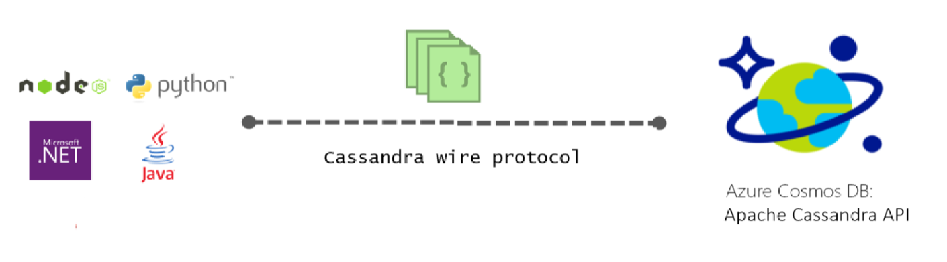
API for Cassandra
Azure Cosmos DB databases can be used as the data store for apps written for Cassandra
You can use your existing Cassandra expertise, application code, and tooling to be deployed in Azure Cosmos DB
Notes:
https://docs.microsoft.com/en-us/azure/cosmos-db/cassandra-introduction
Azure Cosmos DB can be used as the data store for apps written for Apache Cassandra, by using the Apache Cassandra API. This means that by using existing Apache licensed drivers compliant with CQLv4, your application written for Cassandra can now communicate with the Azure Cosmos DB Cassandra API. In many cases, you can switch from using Apache Cassandra to using Azure Cosmos DB 's Apache Cassandra API, by simply changing a connection string. Using this functionality, you can easily build and run Cassandra API database applications in the Azure cloud with Azure Cosmos DB's global distribution and comprehensive industry-leading SLAs, while continuing to use familiar skills and tools for Cassandra API.

Slide 29
Capabilities and Features of Cosmos DB for Cassandra built Applications
No operations management
Performance management
Automatic indexing
Ability to use existing code and tools
Throughput and storage elasticity
Global distribution and availability
Choice of consistency
Enterprise Grade
Notes:
https://docs.microsoft.com/en-us/azure/cosmos-db/cassandra-introduction
No operations management: As a fully managed cloud service, Azure Cosmos DB Cassandra API removes the overhead of managing and monitoring a myriad of settings across OS, JVM, and yaml files and their interactions. Azure Cosmos DB provides monitoring of throughput, latency, storage, availability, and configurable alerts.
Performance management: Azure Cosmos DB provides guaranteed low latency reads and writes at the 99th percentile, backed up by the SLAs. Users do not have to worry about operational overhead to ensure high performance and low latency reads and writes. This means that users do not need to deal with scheduling compaction, managing tombstones, setting up bloom filters and replicas manually. Azure Cosmos DB removes the overhead to manage these issues and lets you focus on the application logic.
Ability to use existing code and tools: Azure Cosmos DB provides wire protocol level compatibility with existing Cassandra SDKs and tools. This compatibility ensures you can use your existing codebase with Azure Cosmos DB Cassandra API with trivial changes.
Throughput and storage elasticity: Azure Cosmos DB provides guaranteed throughput across all regions and can scale the provisioned throughput with Azure portal, PowerShell, or CLI operations. You can elastically scale storage and throughput for your tables as needed with predictable performance.
Global distribution and availability: Azure Cosmos DB provides the ability to globally distribute data across all Azure regions and serve the data locally while ensuring low latency data access and high availability. Azure Cosmos DB provides 99.99% high availability within a region and 99.999% read and write availability across multiple regions with no operations overhead. Learn more in Distribute data globally article.
Choice of consistency: Azure Cosmos DB provides the choice of five well-defined consistency levels to achieve optimal tradeoffs between consistency and performance. These consistency levels are strong, bounded-staleness, session, consistent prefix and eventual. These well-defined, practical, and intuitive consistency levels allow developers to make precise trade-offs between consistency, availability, and latency. Learn more in consistency levels article.
Enterprise grade: Azure cosmos DB provides compliance certifications to ensure users can use the platform securely. Azure Cosmos DB also provides encryption at rest and in motion, IP firewall, and audit logs for control plane activities.

Slide 30
API for Cassandra Queries
Ability to import Cassandra data into Azure cosmos DB
Utilize the Cassandra Query Language (CQL)
Notes:
Queries
Cassandra utilizes it's own unique query language named Cassandra Query Language (CQL). At the simplest level, you can use the cassandra query shell (cqlsh) to interact with Cassandra and issue queries directly against the database. If you are already familiar with SQL, than it should be simple to pick up the CQL language
** maybe add this video here
https://www.youtube.com/watch?v=1Sf4McGN1AQ or https://www.youtube.com/watch?v=gFxJnegGG0o

Slide 31
Migration Tools
Cqlsh Copy Command
Copy Table with spark
Striim(Oracle DB/Apache Cassandra)
Blitzz(Oracle DB/Apache Cassandra)
Notes:
Check out the Azure Database Migration Guide! - https://datamigration.microsoft.com/
https://docs.microsoft.com/en-us/azure/cosmos-db/cassandra-import-data
To import Cassandra data into Azure Cosmos DB for use with the Cassandra API, use the following guidance:
Log in to the Cassandra Query Language (CQL) COPY command (cqhsh) using the connection information from the portal.
Use the CQL COPY command to copy local data to the Apache Cassandra API endpoint. Ensure the source and target are in same datacenter to minimize latency issues.
TOOLING - CASSANDRA
CQLSH
Installed as part of Apache Cassandra
Use the CQL COPY command to copy local data to the Azure Cosmos DB using the Cassandra API endpoint
COPY exampleks.tablename FROM filefolderx/*.csv
SPARK
You can optionally create a Spark cluster to preform a one-time or regularly-scheduled ingestion job to import data into Azure Cosmos DB using the Cassandra API endpoint
Provision an Azure Databricks cluster or an HDInsight cluster
Move data to the destination Cassandra API endpoint by using the table copy operation
Migrating data by using Spark jobs is a recommended option if you have data residing in an existing cluster in Azure virtual machines or any other cloud.
Striim
By using Striim solution in azure, you can continuously migrate data to cosmosdb from various sources such as Oracle, apache Cassandra.
Offers continuous real-time data movement from data warehouses and databases to azure.
Can perform in-line denormalization, data transformation, enable real-time analytics, data reporting scenarios.
https://docs.microsoft.com/en-us/azure/cosmos-db/cosmosdb-cassandra-api-migrate-data-striim
Blitzz
It offers automatic migration of business logic (tables, indexes, views) from Oracle database to Azure Cosmos DB. You don’t have to create schemas manually.
Blitzz offers high-volume and parallel database replication. It enables both the source and target platforms to be in-sync during the migration by using a technique called Change-Data-Capture (CDC). By using CDC, Blitzz continuously pulls a stream of changes from the source database(Oracle) and applies it to the destination database(Azure Cosmos DB).
It is fault-tolerant and guarantees exactly once delivery of data even during a hardware or software failure in the system.
It secures the data during transit using a variety of security methodologies like SSL, encryption.
It offers services to convert complex business logic written in PL/SQL to equivalent business logic in Azure Cosmos DB.
https://docs.microsoft.com/en-us/azure/cosmos-db/oracle-migrate-cosmos-db-blitz

Slide 32
Knowledge Check
Is it possible to create multiple tables with Apache Cassandra API of Azure Cosmos DB?
True/False: I do not have to create multiple indexes to satisfy the queries
Notes:
Is it possible to create multiple tables with Apache Cassandra API of Azure Cosmos DB?
Yes, it is possible to create multiple tables with Apache Cassandra API. Each of those tables is treated as unit for throughput and storage
True/False: I do not have to create multiple indexes to satisfy the queries
True, Azure Cosmos DB provides automatic indexing of all attributes without any schema definition. This automation frees developers to focus on the application rather than on index creation and management. For more information, see Azure Cosmos DB: Indexing policies.

Slide 33
Questions?

